Slide 1
Intro to Digital (Logic)
Budi Rahardjo
2023

Slide 2

Analog and Digital Worlds

Slide 3
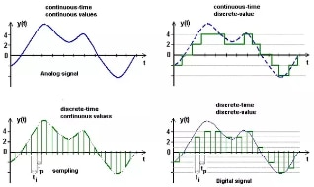
Analog to Digital

Slide 4
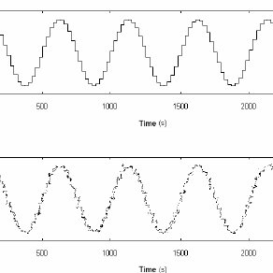
Digital
Discrete value
0, 1
0, 1, 2, 3, 4, ...
(the number of bits)
Analog data is converted to digital data

Slide 5
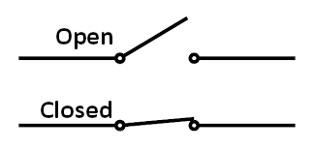
What is “0” or “1”?
Switch
0 = open
1 = closed
Voltage
0 = 0 Volt
1 = 5 Volt (or 3.3 Volt)

Slide 6
Algorithm
A set of instructions
Executed from top to bottom

Slide 7
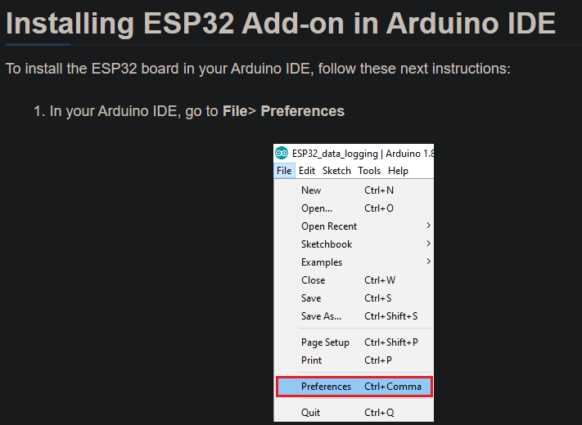

Slide 8
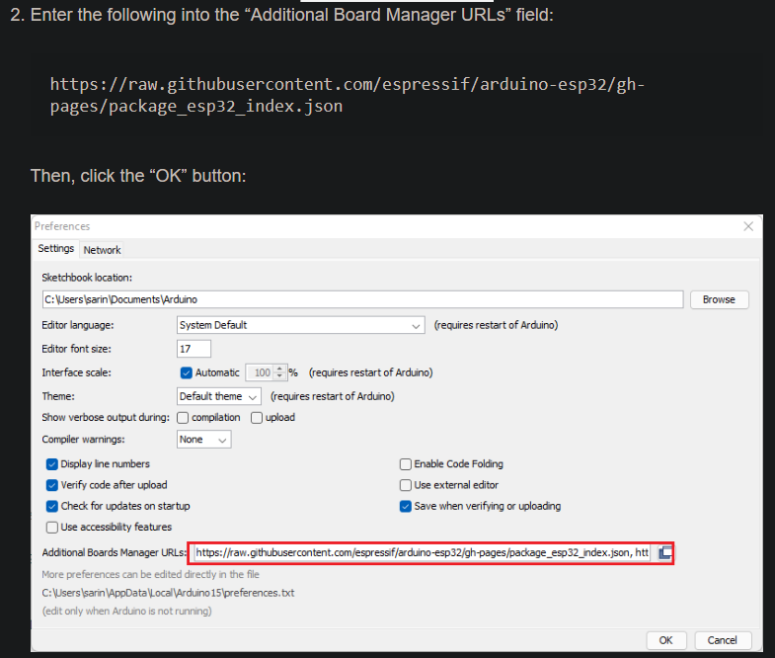

Slide 9
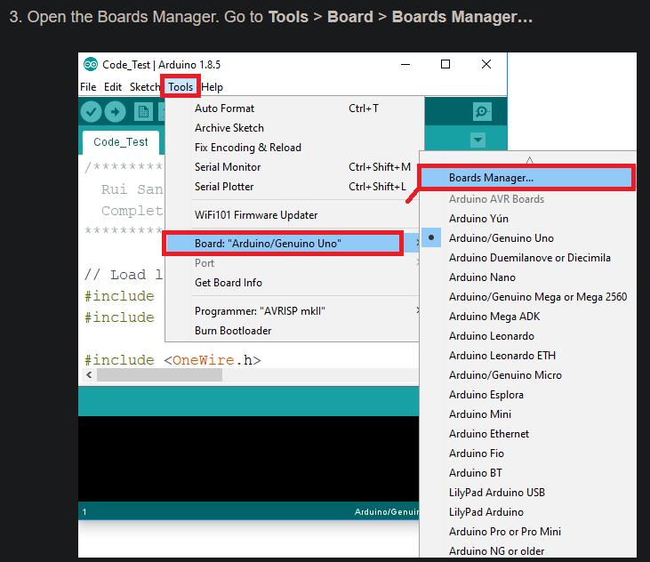

Slide 10
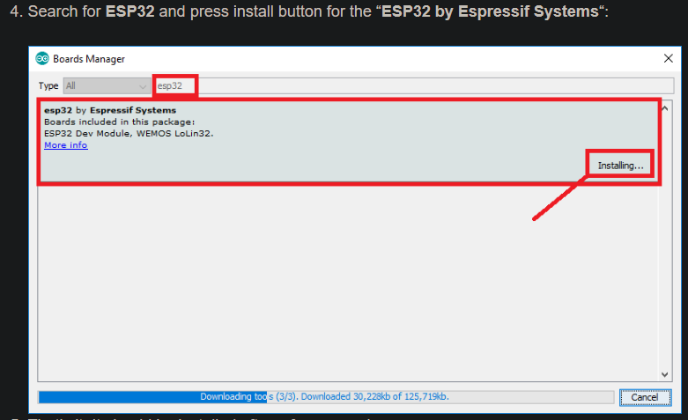

Slide 11
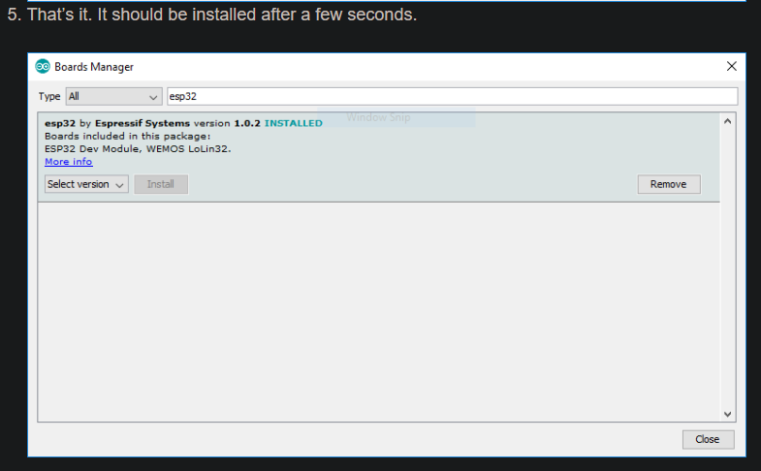

Slide 12
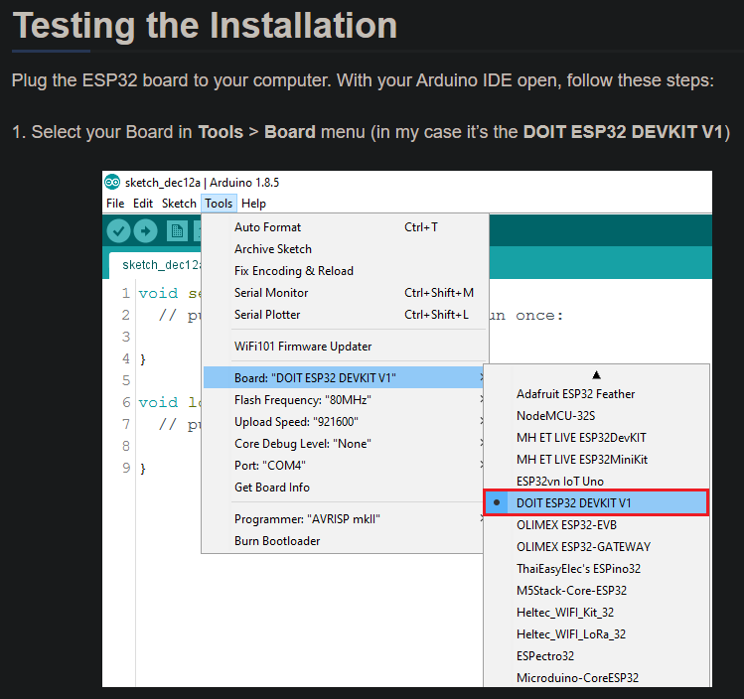

Slide 13
